Slide 1
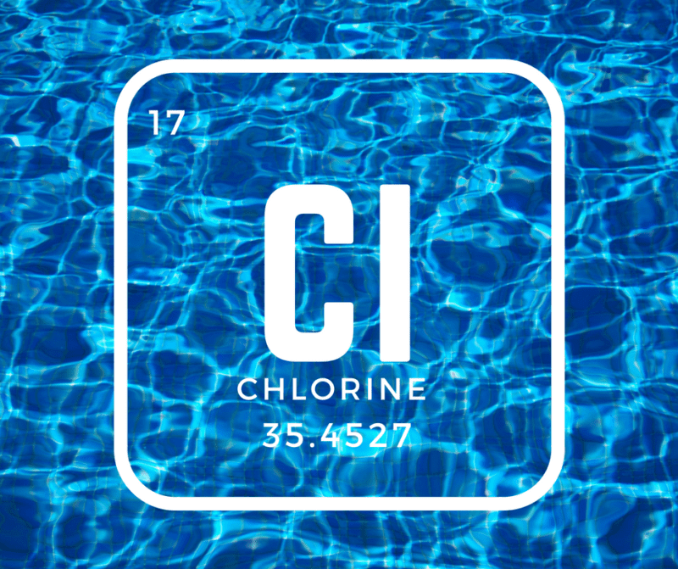
Global Market of Chlorine
Global Techno-Commercial Feasibility Report

Slide 2
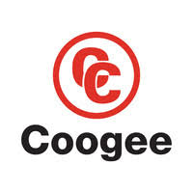
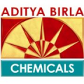
Executive Summary
Global & Indian Chlorine Market 2020-21 in a Nutshell
by Volume
10,000t
by Value
~ $62m
Global Chlorine
Market
by Volume
24KT
by Value
$15.6M
Growth rate
2017-2022
5%
2020-21
by Volume
10,000t
by Value
~ $62m
Indian Chlorine
Market
by Volume
2.7KT
by Value
$1.7M
Growth rate
2017-2022
2%
Global Chlorine Manufacturers Market share by Geography
Global Chlorine Manufacturers
by Geography
Top Global Manufacturers
Cuf-quimicos
Industrias
Coogee chemicals
Aditya Birla
Chemicals
Pt. Sulfindo Adi
Usaha
2020-21
2020-21
Total No. of Buyers of global (Chlorine) is with the buying quantity of 24KT
The report also contains the profile of country wise buyers with their buying quantities & contact details

